Slide 1

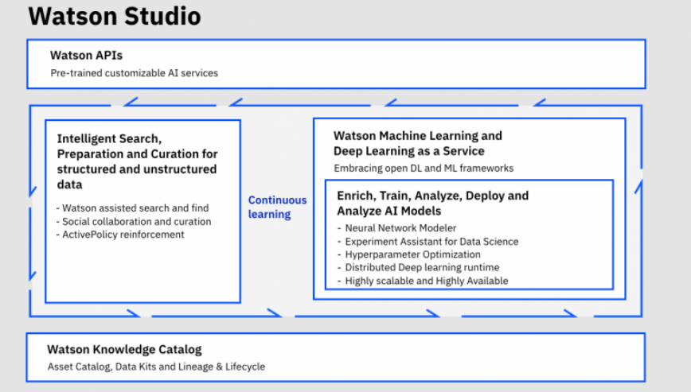

Machine learning and AI made easy!
Alok Kumar
Client Technical Professional
Cloud
Analyze your data with the latest data science tools in a collaborative environment.
Churn Prediction with SPSS Random Tree on Apache Spark 2.0

Slide 2

Setting the Stage….
What I am going to cover…
Speaking to you today…
Analytics Landscape
What is Predictive Analytics
CRISP-DM Methodology
Watson Studio – Overview
Watson Studio - Features
Demonstration
Alok Kumar
Data Scientist
Client Technical Professional
Analytics – Platform
Software Group
IBM
Sample Use Cases…
Telco Churn Prediction with SPSS Random Tree
Notes:
2
My name is Alok Kumar and I am the Client Technical Professional IBM SPSS Predictive Analytics. Today I will be showcasing the capability of IBM SPSS Modeler & IBM SPSS Statistics. I will also present some of the use cases on Crime Prediction and Prevention.

Slide 3



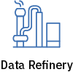
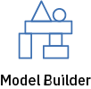
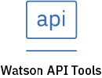








What is IBM Watson Studio
Tools for supporting different skills
Create, collaborate, govern and integrate
Using best of breed - Open source & IBM tools
Code (R, Python or Scala) and no-code/visual modeling tools
Authoring Tools
Decision Optimization
Cognos Dashboards
Most popular open source frameworks
IBM best-in-class frameworks
Workflow driven data science
Machine Learning Runtimes
Deep Learning Runtimes
Fully managed or customer managed service
Container-based resource management
Elastic pay as you go cpu/gpu power
Train models on data where it lives
Scalable & modern infrastructure
Deployment options:
Desktop - Windows & macOS
Fully Managed on IBM Cloud
Local – Deploy it anywhere
3
Private Cloud - Embedded in ICP4D

Slide 4
What is Watson Machine Learning Simplifying Deployment & Management of ML models in production apps
Embed Machine Learning in your Business
Push analytics to Data
Deploy & Manage
Automate ML
ML close to data for faster and secure insights
Manage models and versions
Your models always learning with a feedback loop
Connect to remote Hadoop and Spark clusters to train ML models at scale
Move analytics to the data, access data from Hadoop and combine it with RDBMS to expand data access and optimize performance.
Simplify big data analysis for analysts and business users.
Save models on a central repository with version control built in
Portable models – deploy in the cloud, on devices or on premise
Import models trained somewhere else and deploy in WML
Transfer models to connected devices (e.g. Core ML, Tensorflow Lite)
Deployment flexibility: Shiny apps, scripts, DO and WEX models
Automate the retraining of models with feedback loop capabilities
Automate the deployment of models in products
Automate the Hyperparameter Optimization and Feature Engineering to rapidly train models
A/B testing of models and performance Monitoring
Deployment options:
3
Fully Managed on IBM Cloud
Local – Deploy it anywhere
Private Cloud - Embedded in ICP4D
Notes:
Modeler has a very broad range of modeling algorithms, grouped by their usage.
Classification, Segmentation and Association
Classification includes techniques such as decision trees, regression or neural networks and is typically used to predict group membership. For example, will this employee leave? Or to predict a customer value.
Segmentation algorithms are used to put data into groups and predict group membership for new cases. Association finds events that occur together or in a sequence. These techniques are used for market basket analysis where users are looking to see what products are bought together and in what order.
There are also some automated modeling procedures which enable users to quickly generate multiple models and evaluate their performance before selecting which is the most appropriate to use in each case.

Slide 5
Converging IBM Offerings: Build & Operationalize
Watson Studio
Watson Machine Learning
Data Exploration
Model Development
Data Preparation
Deployment
Retraining
Model Management
Build
Operationalize
Notes:
We refer to this as the “Ring Diagram”. It takes the “analytics maturity curve” and moves it into a cycle, reinforcing the evolution and interconnection between all the pieces.
The assumption for this whiteboard is that you are speaking with a role in an organization that will benefit from the vision setting purpose of this discussion.
1. This is a more “customer friendly” version of the diagram with product names removed so we can focus on the IBM strategy and Value Prop, not individual products.
2. You can begin this discussion anywhere on the ring, but generally you want to start with either:
Existing Customer. Start with what they already own and expand, or one of the solutions they already own if they do.
New Customer. The solution you are trying to sell them if they don’t have any IBM BA products. Typically we start with Descriptive or Planning as every customer is doing some of those processes, even if it is just in Excel. So its easy for them to relate to the Use case and benefits.
Point out how each one of these solution areas helps companies drive better performance, and could look at this as almost a high level “project plan” for infusing Analytics throughout their organization.
Leveraging data and driving better decisions and outcomes should be the goal of any company’s analytics strategy. In fact, those companies that make data driven decisions consistently outperform their peers. Choosing how and where to start, and the right tools for the job, are often a difficult decision. While you could really start anywhere, we believe that gradually progressing through an analytics maturity cycle and layering on solutions that build upon one another is a sound approach. I’m going to take a few minutes to review the characteristics of each type of solution and how they work together.
---------------------------------------------
IBM is unique in its ability to deliver on this lifecycle of turning data into insight and insight into action. IBM Planning Analytics provides a market leading tool for building your business plans, this integrates with Cognos Analytics that lets you track actuals and compare to your plans. Watson Analytics provides the smart data discovery component that can help you understand why you may be tracking on or off plan. SPSS or Data Science Experience provide leading predictive analytics capabilities including forecasting and prescriptive analytics such as optimization. These capabilities complement and are integrated with business planning to enable constraint based planning and forecasting.
This system is based upon trusted data and a governance process to ensure that the insights for crucial decisions can be relied on.

Slide 6
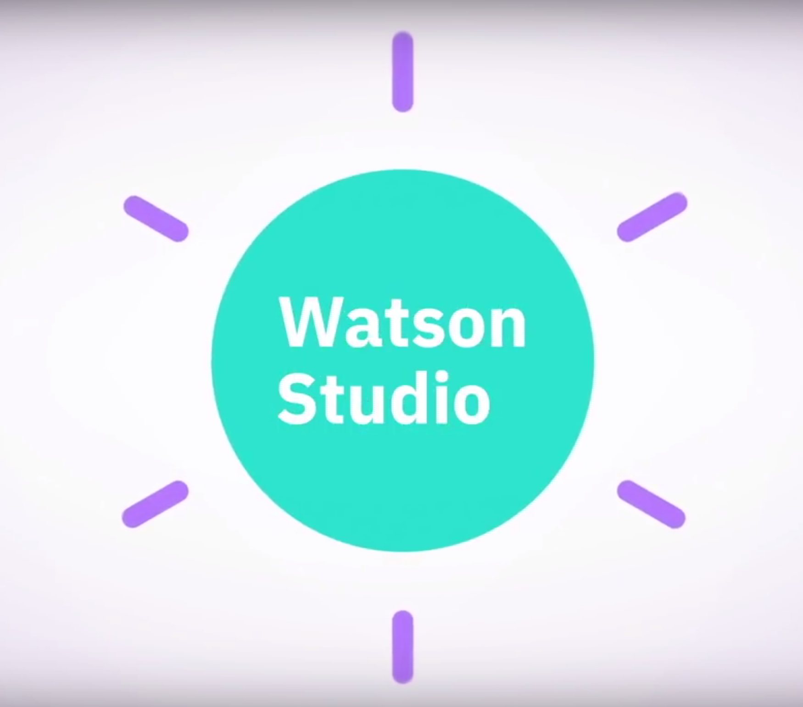
IBM Watson Studio – Fundamentals
Self-contained and extendable platform for developing and deploying analytics applications
Works with multiple run-times, multiple data sources, user management, model management and supports adding additional libraries
Deployment Options
As a cloud offering – Watson Studio Public or Cloud
As an on-premises solution – Watson Studio Local
As a desktop application – Watson Studio Desktop
Watson Studio brings together all the tools that companies need to embed AI in their business and become data-driven

Slide 7
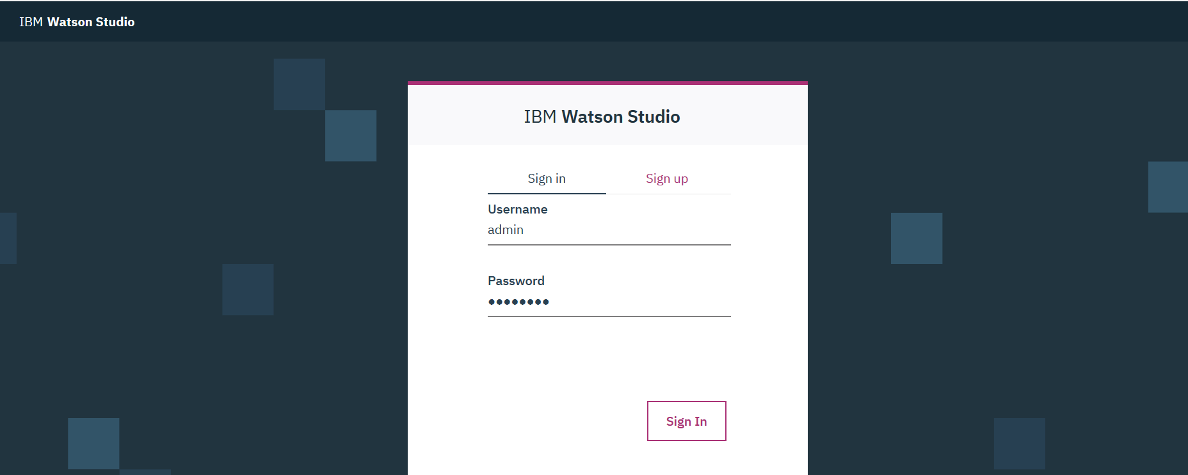
IBM Watson Studio Local - Demo
IBM Watson Studio Cloud
IBM Watson Studio Local
Quick overview
Watson Studio Local is a social environment where you can collaborate to solve data challenges with the best tools and most recent expertise.
Notes:
Share the video demo of Watson Studio Local. This demo will be updated and improved from time-to-time. Save it locally to your laptop to avoid network latency.

Slide 8
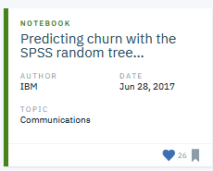
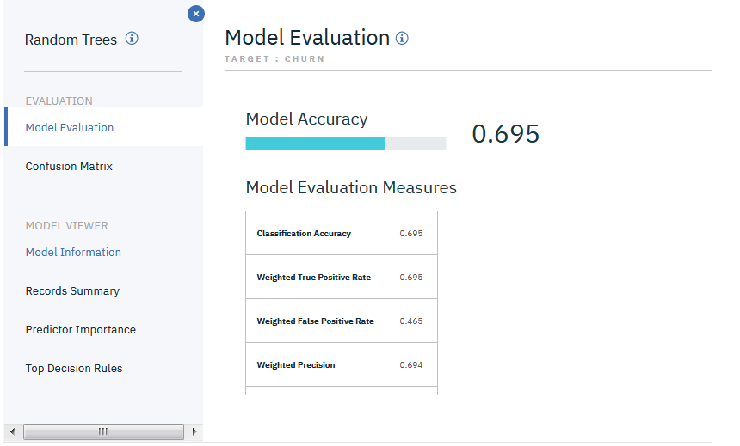
Jupyter Notebook: Scala 2.1 (IBM Watson Studio Cloud)
Use Case : Churn Prediction
Model : SPSS Random Tree (C&RT) on Apache Spark 2.0
Objective: You'll learn how to create an SPSS random tree model by using the IBM SPSS Machine Learning API, and how to view the model with IBM SPSS Model Viewer.
Steps
Load the Telco Churn Data to the Cloud Data Repository
Prepare the data
Configure the RandomTrees model
View the model
Demo
Notes:
Projects allow different users and personas to share sets of assets while building their data products. For example, you can create a Project, add in your assets such as a notebook and files in object storage, and then add collaborators such as your co-workers. Your collaborators can have different permission rights too. Maybe you’ll make some of your collaborators Editors of the Project, others Viewers, and maybe a couple of people will have Admin rights.
You can also easily share notebooks with others by posting its permalink in view-only mode on Twitter, GitHub, Slack, and so on.

